Slide 1
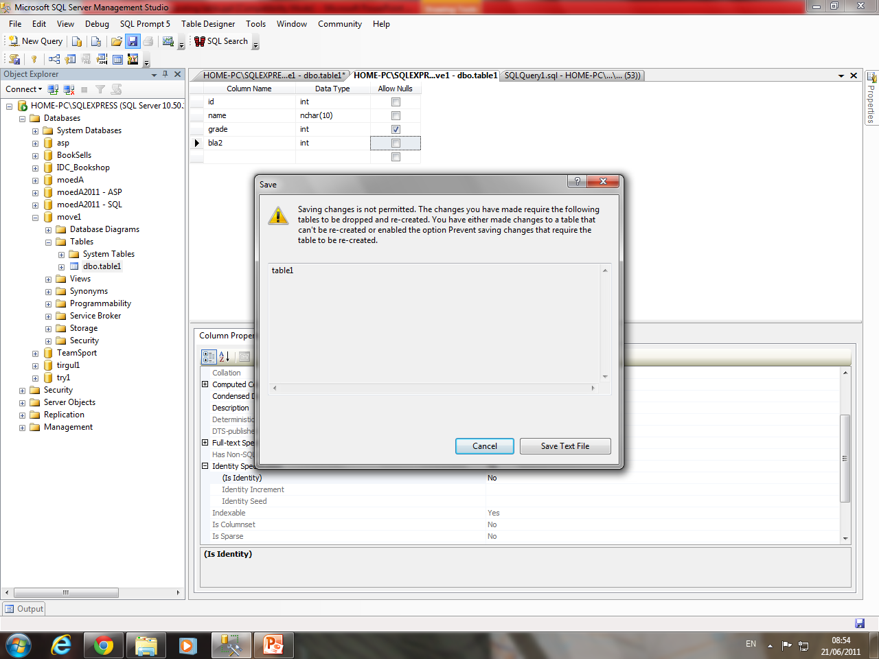
If you have problems making changes to an existing table

Slide 2
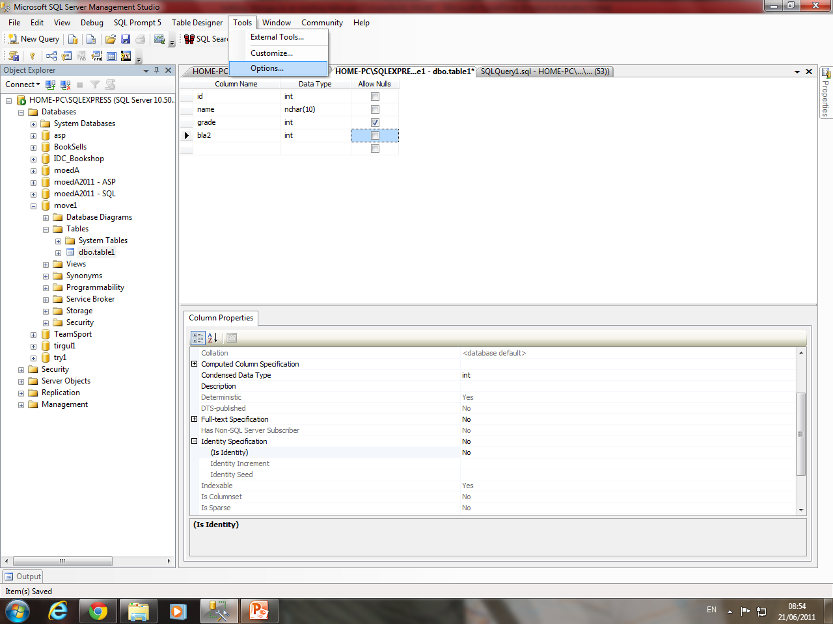

Slide 3
